Slide 1
Usage of Bikes Between Members and Casuals
Presenter: David Seo
Last Updated: 4/23/22

Slide 2
Sources
Data was obtained directly from:
https://divvy-tripdata.s3.amazonaws.com/index.html
License to use data:
https://ride.divvybikes.com/data-license-agreement

Slide 3
Business Task and Objective
Business Task: What could motivate casual riders to change to an annual subscription?
Compare how member and casual bike riders differ
Figure out how to advertise membership to casual riders
Use R and Tableau

Slide 4
Wrangling Data
Data was divided into four separate CSV files
CSV files were uploaded and created into data frames in R
Renamed column names to make it consistent across all files
Converted certain columns to the same data type
Combined all four data frames into one
Removed unnecessary fields

Slide 5
Data Cleaning / Manipulation
Within “member_casual” column, entities “Subscriber” and “Member” were combined. Same with “Customer” and “Casual”.
Added date, month, day, and year of each ride as new columns
Added “ride_length” calculation
Converted “ride_length” from Factor to Numeric for calculations
Removed data were “ride_length” was negative or when bikes were taken out by staff.

Slide 6
Descriptive Analysis
Compared members and casuals (In Minutes)
Mean
Casuals – 3552 , Members - 850
Median
Casuals – 1546 , Members – 589
Max
Casuals – 9387024 , Members - 9056634
Min
Casuals – 2 , Members – 1
Average ride time by each day for members vs casuals
Analyzed ridership data by type and weekday

Slide 7
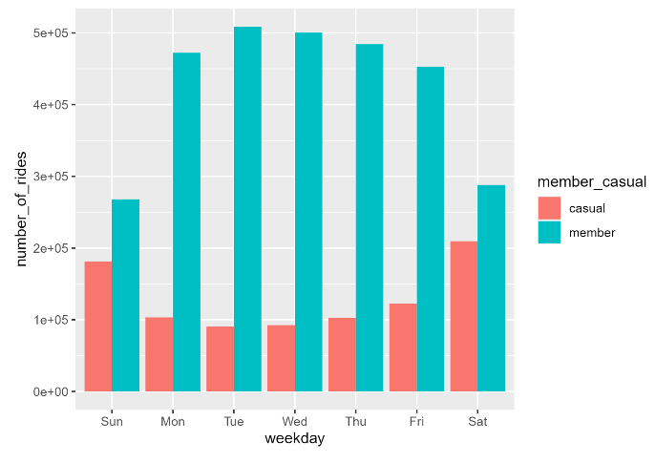
Number of Riders by Rider Type
During the weekdays, there are a lot more members using the bikes compared to casuals
During the weekends, there are still more members using the bikes, however, the gap is much smaller

Slide 8
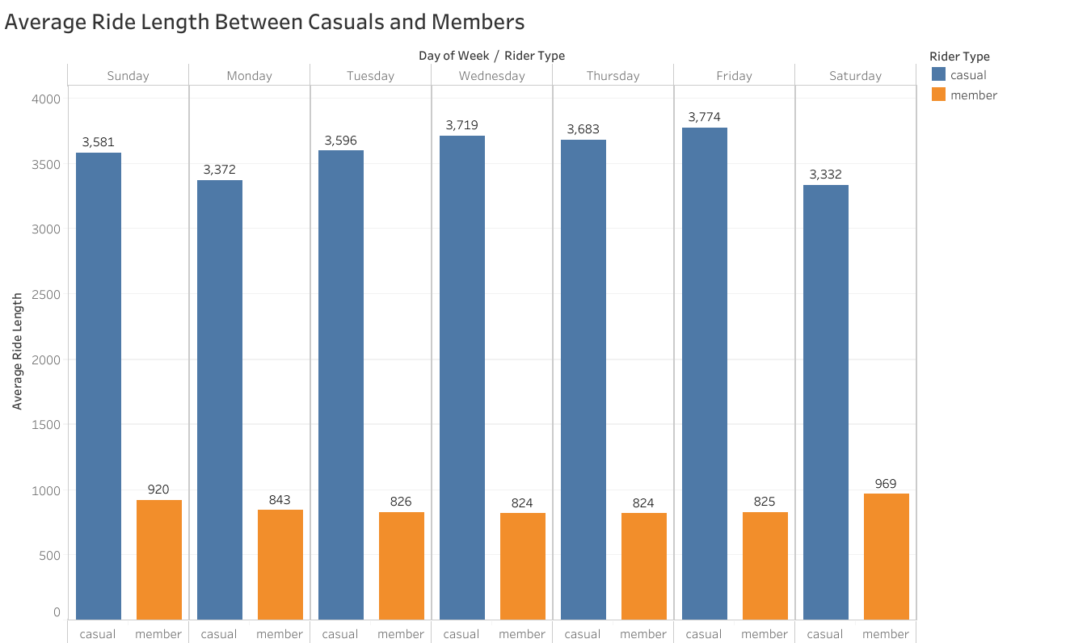
Average Ride Length
Casuals are riding their bikes for a much longer period of time compared to members
This trend is consistent throughout the week

Slide 9
Takeaways
There are more casuals renting bikes on the weekends compared to the weekdays
There are less members renting bikes on the weekends compared to the weekdays
Casuals are taking much longer rides even though there are fewer casual riders per day
Members use the bikes more for shorter periods of time
Casuals use the bikes less for longer periods of time

Slide 10
Suggestions
Add a trip overage fee for bike usages that go over a certain duration
Advertise a weekend only pass where riders can use the bikes for an unlimited duration with no fee (duration is unlimited, not the number of times they can rent out the bike)
Advertise a weekday only pass where riders can receive unlimited 45-minute rides, however, there is a fee if they go over the duration
Advertise a full membership pass where members are able to use the bikes for unlimited rent outs and duration
Goal is to offer different levels of passes in order to entice casuals who may not want to commit to the full membership right away

